Slide 1
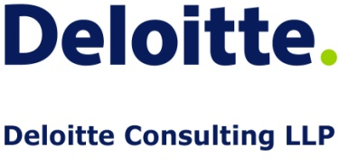
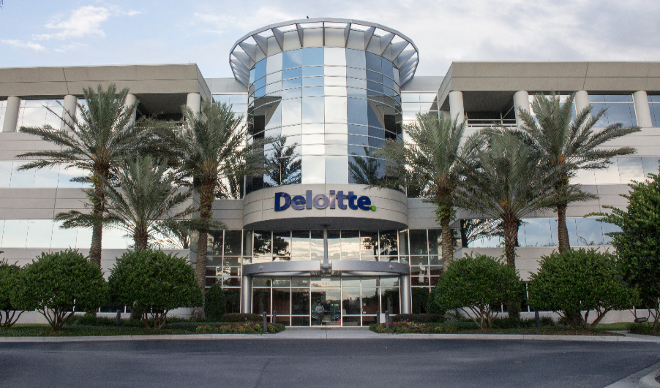
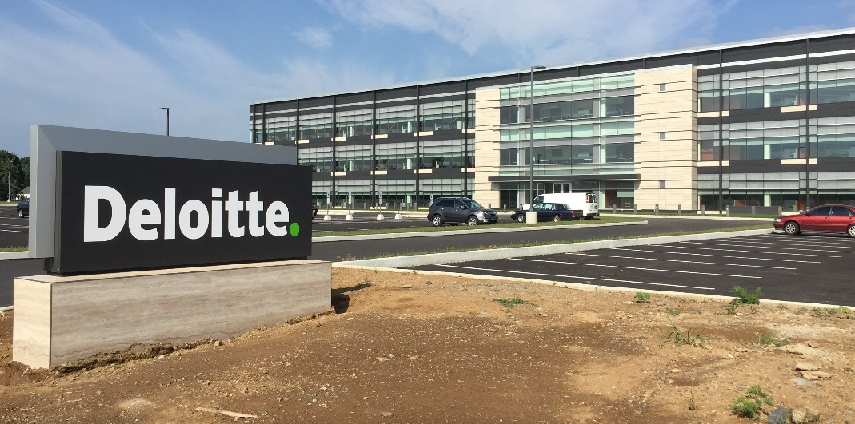
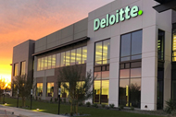
USDC Information Technology Center of Excellence (IT-CoE)
Topic: CompTIA Security+ Testing Review
Orlando, FL
Mechanicsburg, PA
Gilbert, AZ

Slide 2
Risk Management, Security Policies, and Standards
Session 12
Security+
CompTIA Security+
Test: SYO-601
EXAM OBJECTIVES (DOMAINS)
The table below lists the domains measured by this examination and the extent to which they are represented:
Domain | Weight
1.0 Threats, Attacks and Vulnerabilities | 24%
2.0 Architecture and Design | 21%
3.0 Implementation | 25%
4.0 Operations and Incident Response | 16%
5.0 Governance, Risk, and Compliance | 14%
Total | 100%
Session 12
Includes Objectives from Domain 5
Objective 5.2 – Explain the importance of applicable regulations, standards, or frameworks that impact organizational structure.
Objective 5.3 – Explain the importance of policies to organizational security.
Objective 5.4 – Summarize risk management processes and concepts.
Objective 5.5 – Explain the importance of policies to organizational security.

Slide 3
Risk Management, Security Policies, and Standards
Session 12
Security+
Terminology
Asset – An item of value. Such as data, hardware, software, or physical property.
Risk – The probability or likelihood of the occurrence or realization of a threat, either accidentally or intentionally leaving a system or asset vulnerable and the impact of this occurring.
Vulnerability – A weakness in hardware, software, or components that may be exploited in order for a threat to destroy, damage, or compromise an asset.
Threat – Any agent, condition, or circumstance that could potentially cause harm, loss, damage, or compromise to an organizations physical or IT assets or data assets.
Motivation – The driving force behind a threat activity.
Risk Source – Can be internal or external. Internal risk can be a disgruntled employee or a failed hard drive. External risks include natural disasters, floods, strikes, protests, storms, etc.
BIA – Business Impact Analysis. A thoughtful study of the possible impact of a disruption of an organizations’ business critical resources.

Slide 4
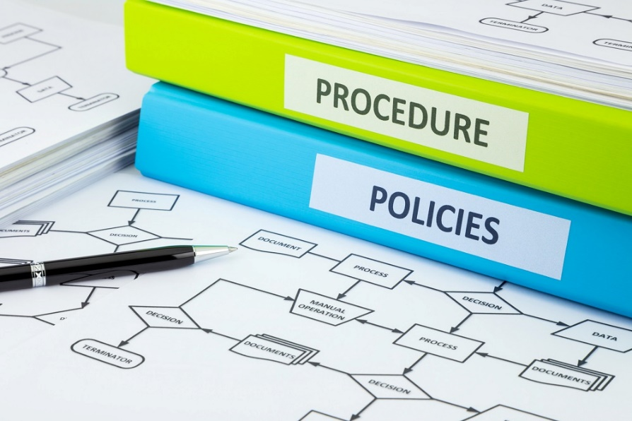
Risk Management, Security Policies, and Standards
Security+
Session 12
Policies and Procedures are the ‘Controlling’ documents that define and dictate how the business functions and operates on a daily basis.
Policies and Procedures
Policies – high level documents, developed and approved by management to define the overall strategy and philosophy of the organization to all employees.
Security Policy – defines the organizations commitment to the secure use and operation of the organizations IT systems. This policy covers logical as well as physical systems controls.
Procedures – detailed documents that define and support a parent policy. Procedures describe the detail way in which policies are implemented. Examples are that a policy would mandate a firewall to control internet traffic, and a procedure would describe the exact equipment and the configuration of that equipment to meet the mandate of the policy.

Slide 5
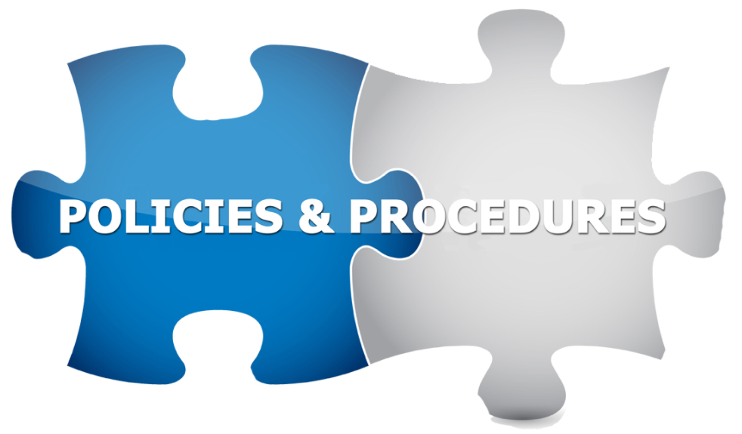
Risk Management, Security Policies, and Standards
Security+
Session 12
Developing Policies, Standards, and Guidelines
Policy Types
Regulatory – assure that the organizations standards are in accordance with local, state, and federal laws.
Informative – Created to teach and guide employees to understand and comply with specific organizational rules. These are primarily educational in nature, of the organizations operating policies.
Advisory – Designed to ensure that employees know the organizations internal rules, and the consequences of any behavior and actions. An example of this would be the Acceptable Use Policy for use of the internet during working hours or with company equipment. Violations of this policy could result in discipline, up to and including termination.

Slide 6
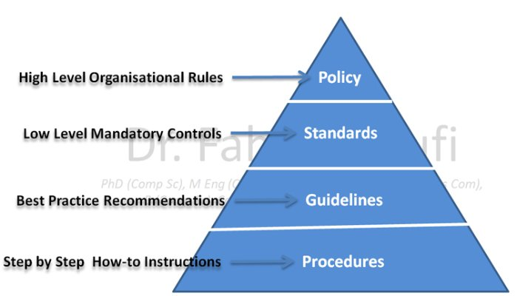
Risk Management, Security Policies, and Standards
Security+
Session 12
Developing Policies, Standards, and Guidelines
Documents and Terms
Standards – considered tactical documents instead of strategic. Standards define specific processes needed to meet an organization requirement. Example, the company has set a standard that all laptops use full disk encryption.
Baselines – the minimum level of security required for a system, network or device.
Guidelines – a statement in a policy or procedure that is used to determine a course of action. There is flexibility in guidelines, and can be called best practices.

Slide 7
Risk Management, Security Policies, and Standards
Security+
Session 12
Developing Policies, Standards, and Guidelines
Review and Update Policies and Procedures
Review Period – 6 months to 5 years (best timeframe should be examined)
Questions for the review process:
Have laws changed
Is the policy relevant
Is change management process working
Has industry best practices changed
Have audits found significant problems
Payment Card Industry Data Security Standard (PCI) – companies that process and handle credit card information must implement these controls to protect cardholder data.

Slide 8

Risk Management, Security Policies, and Standards
Security+
Session 12
Implementing Policies for Personnel
Employee Policies
Pre-Employment Policies
Background check
Education verification
Non-Disclosure Agreement (NDA)
Employment Policies
Initial training
Employee code of conduct
Acceptable use of company assets
Security practices and policies
Continuous training requirements
Employee Security Controls
Mandatory vacations
Job Rotation
Dual Controls
Separation of Duties
Least Privilege Access

Slide 9

Risk Management, Security Policies, and Standards
Security+
Session 12
Implementing Policies for Personnel
End of Employment and Termination Procedures
Human Resources communicates to IT, legal, management, etc. on employee termination.
Voluntary and In-voluntary termination procedures.
Return all equipment, tokens, keys, ID cards, credit cards, laptops
Exit interviews, review of NDA, suspension of network access.

Slide 10
Risk Management, Security Policies, and Standards
Security+
Session 12
Developing Policies, Standards, and Guidelines
Service Level Agreement (SLA) – defines the level of service that a partner is expecting to provide. Document should specify the uptime, response time, and maximum outage time for services.
Operating Level Agreement (OLA) – supports the Service Level Agreement. Defines the responsibilities of each party and the responsibilities of their internal support group.
Uptime Agreement (UA) – this document defines the agreed amount of uptime for the systems supported between the parties. All equipment and services are included in the document. Examples are 99.999 (called 5 nines) of uptime for the equipment and systems. This is about 5 minutes of downtime per year.

Slide 11
Risk Management, Security Policies, and Standards
Security+
Session 12
Developing Policies, Standards, and Guidelines
Risk Assessment (RA)/Statement of Applicability (SOA) – this document is an outcome of the Risk Assessment process and defines the specific controls chosen for an environment and why those controls are appropriate to meet the security need.
Business Impact Analysis (BIA) – part of the disaster recovery business continuity process. With three components:
criticality prioritization
downtime estimates
resource requirements.
This document can be quantitative or qualitative in design.
Interoperability Agreement (IA) – this document describes the requirements for organizations to establish and maintain agreements to cooperate in a certain area, primarily the sharing of data between companies.

Slide 12
Risk Management, Security Policies, and Standards
Security+
Session 12
Developing Policies, Standards, and Guidelines
Continuity of Operations (COOP) – plans and procedures for a company to continue operations in the event of a catastrophe that would cause all of the primary systems to fail or be unable to function.
Interconnection Security Agreement (ISA) - specifies the requirements for connecting systems and networks and defines what security controls are needed to protect the systems and sensitive data.
Memorandum of Understanding (MOU) – this document defines the terms and conditions for sharing data and information resources with a partner organization. This document is typically a temporary document that is used prior to a formal contract being developed and agreed to.

Slide 13
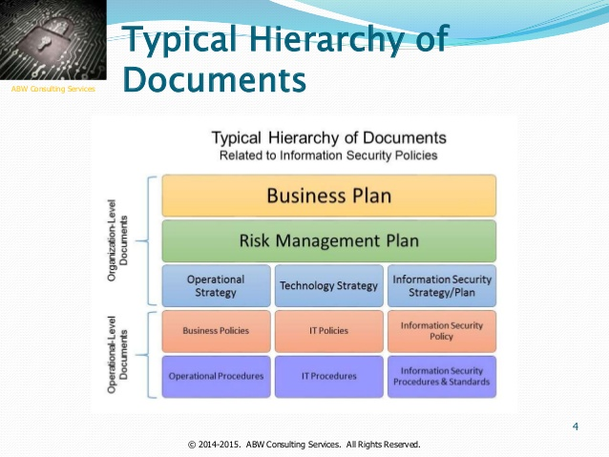
Risk Management
Security+
Session 12
Developing Policies, Standards, and Guidelines
Nondisclosure Agreement (NDA) – designed to protect the organizations confidential information from disclosure to outside parties that should not have access to the information.
Business Partnership Security Agreement (BPA) - defines the actions and expectations of each partner in the agreement with respect to security-related activities.

Slide 14
Risk Management
Security+
Session 12
Developing Policies, Standards, and Guidelines
Documents Summary List
Risk Assessment (RA)/Statement of Applicability (SOA)
Business Impact Analysis (BIA)
Interoperability Agreement (IA)
Continuity of Operations (COOP)
Interconnection Security Agreement (ISA)
Memorandum of Understanding (MOU)
Service Level Agreement (SLA)
Operating Level Agreement (OLA)
Uptime Agreement (UA)
Nondisclosure Agreement (NDA)
Business Partnership Security Agreement (BPA)

Slide 15
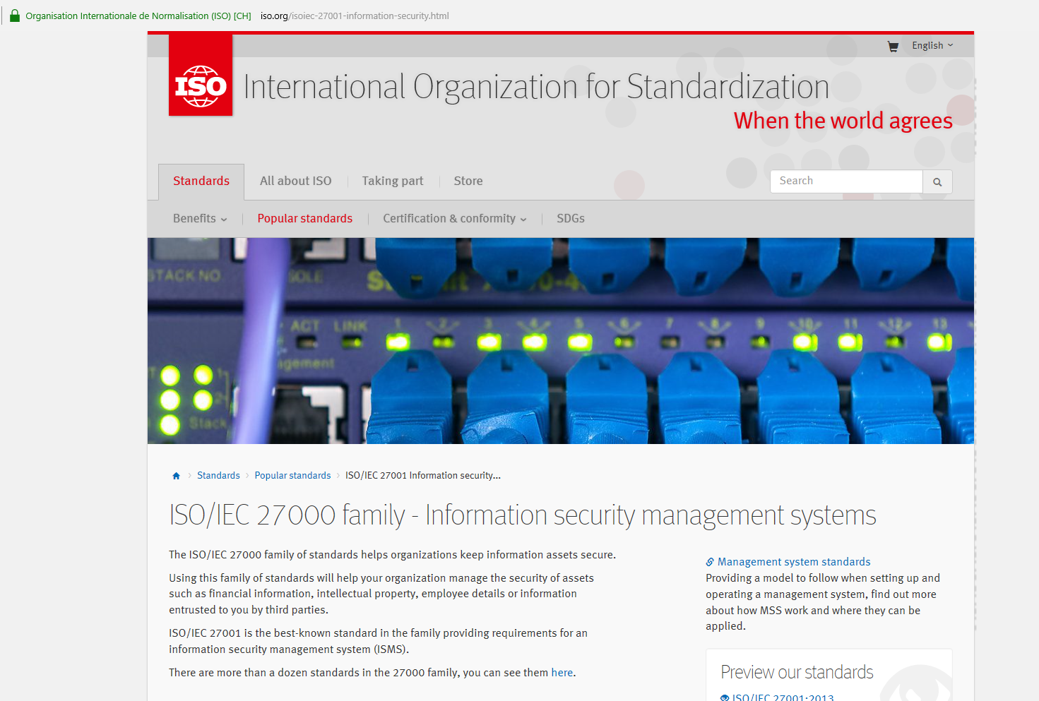
Endpoint and Network Security
Session 9
Security+
Industry-Standard Frameworks and Architectures
ISO Standards
International Organization for Standardization (ISO)
ISO/IEC 27001:2013 – Information technology – Security techniques – Information security management systems - Requirements
ISO 27002 – Standard for cybersecurity
ISO 27017 – Standard for Cloud security

Slide 16
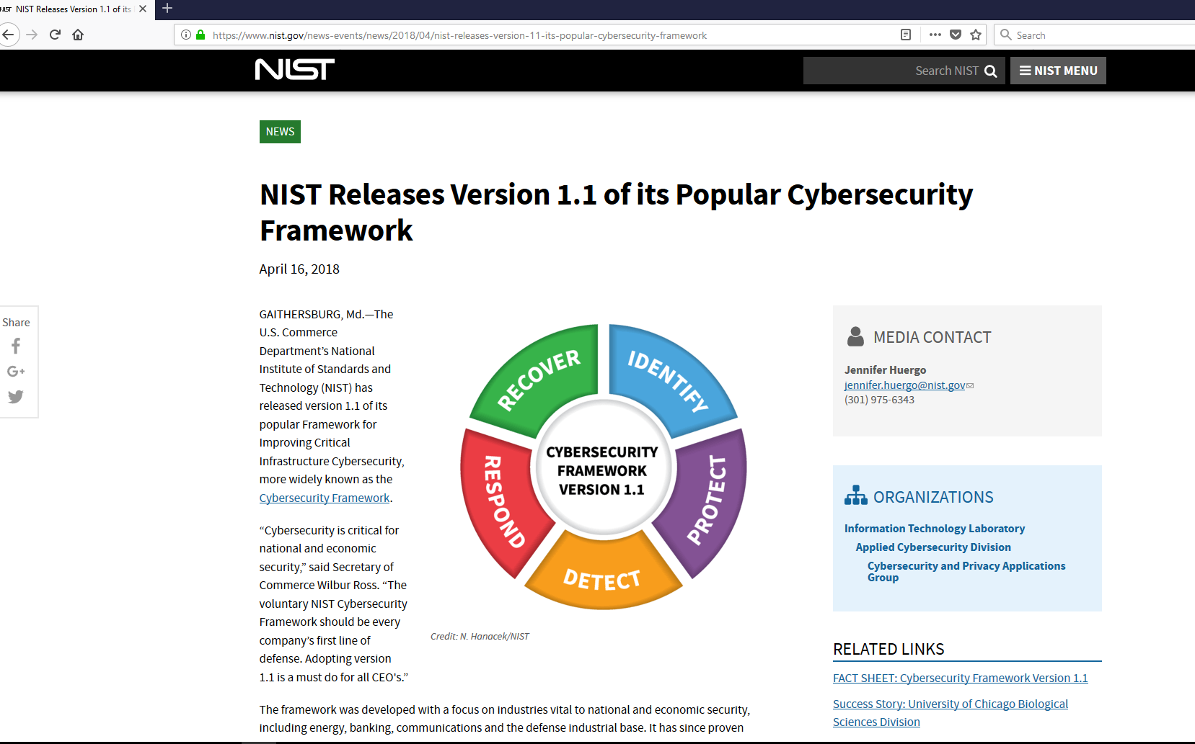
Endpoint and Network Security
Session 9
Security+
Industry-Standard Frameworks and Architectures
NIST
National Institute of Standards and Technology
Source of national standards in the U.S.
NIST CSF – Cybersecurity Framework standards published as Special Publications
NIST SP 800-12 Provides broad overview of computer security
NIST SP 800-14 Common security principles addressed within security policies
(8 principles and 14 policies)

Slide 17

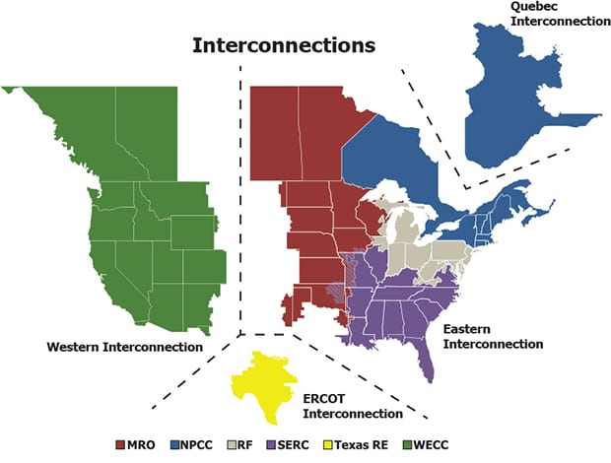
Endpoint and Network Security
Session 9
Security+
Industry-Standard Frameworks and Architectures
NERC
North American Electric Reliability Corporation
Has cyber security standards for the power grid and the authority to enforce those standards to secure this critical infrastructure.
ICS – Industrial Control Systems
And
SCADA – Supervisory Control and Data Acquisition
Systems need regular patching.

Slide 18
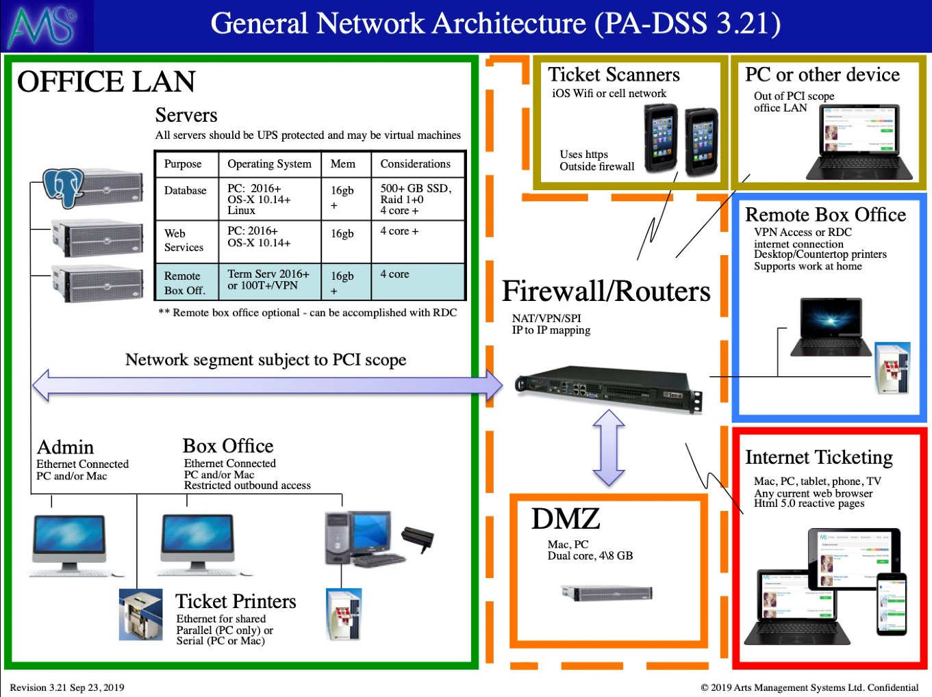
Endpoint and Network Security
Session 9
Security+
Industry-Standard Frameworks and Architectures
PCI-DSS
Payment Card Industry Data Security Standard
Used by Visa, Mastercard, American Express and Discover
Standards for security controls for companies that process credit card transactions.
Latest version of PCI-DSS 4.0 is expected to be released in mid-2021.
Requires reviews and audits of the card transaction processing network quarterly and annual external penetration tests.

Slide 19
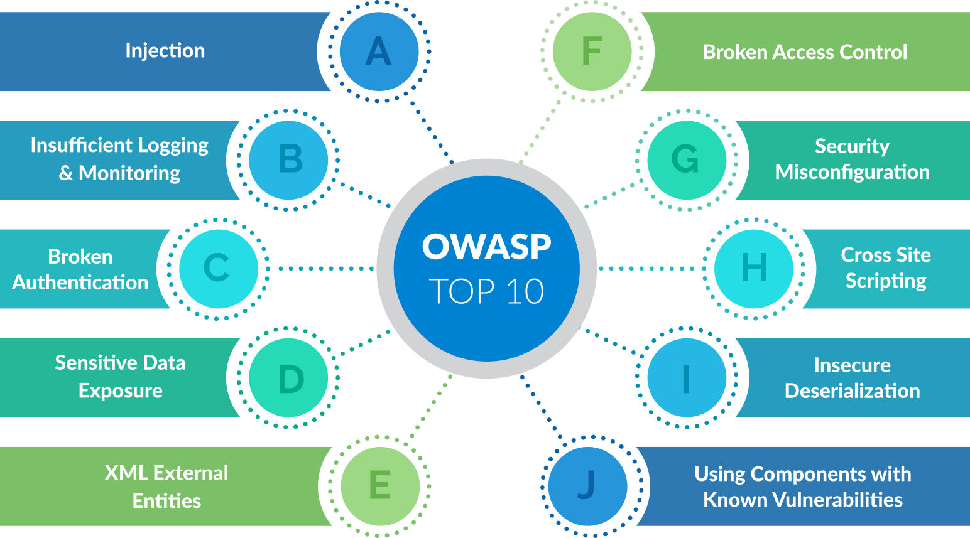
Endpoint and Network Security
Session 9
Security+
Industry-Standard Frameworks and Architectures
OWASP
Open Web Application Security Project
Standards, frameworks, and guidelines for the development of web applications.
https://www.owasp.org/
Tracks and maintains Top 10 list of application security vulnerabilities.

Slide 20
Risk Management, Security Policies, and Standards
Security+
Session 12
Sensitive Information Controls
Personally Identifiable Information (PII) Controls
Data will be collected fairly and lawfully
Data will only be used for the purpose for which it is collected
Data will be kept secure while in storage and in transit
Date will be held for only a reasonable time
Monitor Privacy Policy violations
Privacy Impact Assessment (PIA) – determines the risks and effects of collecting, maintaining, and distributing PII in computer-based systems.
Continually assess the technology, processes, and training with the handling of PII.
Risk in Data Breaches
A data breach is an event when confidential, sensitive, protected, or personal information has been exposed, stolen, used, or viewed by an unauthorized party or parties.
Dealing with Data Breaches:
Minimization – minimize the opportunities for a data breach to occur, with proper controls
Mitigation and Response – Detection, mitigation, evaluation, response, disclosure
Recovery and Reconstruction – Repairing damaged databases and recovery of systems

Slide 21
Social Engineering and Password Attacks
Session 3
Security+
Data Security and Privacy Practices
Confidential
Defines low-level information that needs to remain secret. It is the lowest level of information classification by the military, used to prevent access to sensitive information, and is restricted from public release.
Private
Information that is restricted to use within an organization. This type of information could disclose trade secrets or affect personnel.
Internal information includes personnel records, financial records, customer lists, etc.
Restricted information could damage the organization if disclosed, such as marketing plans.
Public
Information that is available to the public or specific people that need the information. The organization has to make policies to determine what information can be made public, with the idea that it could not cause any harm to the organization if released.
Proprietary
This information is similar to the confidential classification, but this designation is mainly used in the business environment.

Slide 22
Social Engineering and Password Attacks
Session 3
Security+
Data Security and Privacy Practices
PII
Personally Identifiable Information is data that can identify a person. This data is usually individual data fields in a larger context of data concerning a person. PII is social security numbers, credit card numbers, date of birth, mother’s maiden name, or biometric records.
These pieces of information can identify a person and must be safeguarded from release to the public, as well as within the organization, released only to those that have a defined need to view the PII.
PHI
Protected Health Information is a form of PII and must be protected in the same way as PII is protected.
PHI is any information about health status, provision of health care that can be linked to a specific individual.

Slide 23
Social Engineering and Password Attacks
Session 3
Security+
Data Security and Privacy Practices
Data Roles
Owner – Is the person identified by law, contract, or policy with the responsibility for granting access to data to other users and insuring appropriate use of data.
Stewart/Custodian – Is the person or people that is responsible for the physical and electronic security of the data. Systems Administrators, database administrators, or programmer/analyst.
Privacy Officer – Is the person within an organization that is responsible for safeguarding personal information. In medical organizations, this individual is charged with protection of patient medical records to stay in compliance with HIPPA. In financial organizations, they safeguard consumer financial and banking transactions in compliance with Fair Credit Reporting Act and Gramm-Leach-Bliley Act.

Slide 24
Risk Management, Security Policies, and Standards
Security+
Session 12
Common Threats
Categorized as environmental, manmade, and internal vs. external.
Natural Disaster – Events over which we have no control. Bad weather, floods, snowstorms, hurricanes, tornadoes, fires, earthquakes.
Malicious Code – Damaging programs, such as viruses, worms, Trojans, keyloggers, etc. Developed to damage, alter, expose, or destroy a system or data.
Breach of Physical Security – Intruders, vandals, and thieves remove sensitive information, destroy data, or physically damage or remove hardware.
Hacker Attack – Result in stolen, lost, damaged, or modified data.
Distributed Denial of Service – Designed to bring down a network or prevent access to a network, by flooding it with useless traffic.
Cyberterrorism – Hackers that use computers with internet communications to attack critical national infrastructure such as water, electric, gas plants, oil refineries, power plants, etc. to disrupt or deny critical services to the public.

Slide 25
Risk Management, Security Policies, and Standards
Security+
Session 12
The Risk Assessment Process
Assess risks based on likelihood and the magnitude of an impact to determine strategies to respond to events and to monitor progress in reducing risk threats.
Establishing a Baseline for the Risk Assessment.
Asset Inventory
Hardware
Software
Documentation
Data
Goodwill
Services
Asset Valuation
Assessing value to each item in the inventory list based on:
Cost to acquire or create
Liability if the asset is lost
Production cost if the asset is unavailable
Value of asset to competitors
How critical is the asset?

Slide 26
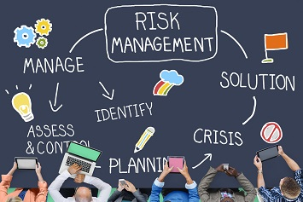
Risk Management, Security Policies, and Standards
Security+
Session 12
The Risk Assessment Process
The Risk Assessment Team
Responsible for identifying and analyzing risks.
Determine the Type of Risk Analysis to use:
Quantitative Risk Assessment or
Qualitative Risk Assessment

Slide 27
Risk Management, Security Policies, and Standards
Security+
Session 12
The Risk Assessment Process
Quantitative Risk Assessment
Loss calculation steps:
Determine the asset value (AV)
Identify threats to the asset
Determine the exposure factor (EF)
Calculate the Single Loss Expectancy (SLE)
Calculate the annualized rate of occurrence (ARO)
Calculate the annualized loss expectancy (ALE).
Quantitative Risk Assessment
Formulas:
SLE = AV x EF
And
ALE = SLE x ARO

Slide 28
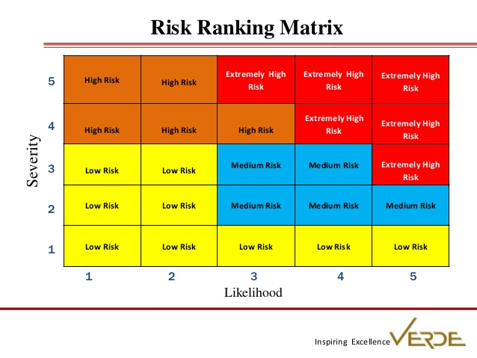
Risk Management, Security Policies, and Standards
Security+
Session 12
The Risk Assessment Process
Qualitative Analysis
Opinion based and subjective.
Scenario based risk analysis. Does not assign dollar values to the risk of potential threats. Assessment ranks the potential of a threat and the sensitivity of assets by a scale of: low, medium or high. Answers the question: What is the potential impact on confidentiality, integrity, and availability of the threat?
Low – Minor inconvenience; can be tolerated for a short period of time, will not result in any financial loss. (Also Very Low)
Medium – Can result in damage to the organization, cost a moderate amount of money and result in negative publicity.
High – Loss of reputation, may result in legal action or fines, cause significant revenue loss. (Also Very High)

Slide 29
Risk Management, Security Policies, and Standards
Security+
Session 12
The Risk Assessment Process
Measuring Risk Terms
MTBF – Mean time between failures indicates the component’s anticipated lifetime. The time that something is expected to last, like an air conditioning system’s lifetime expectancy may only be 7 years before it will be expected to fail and cause disruption in the business.
MTTF – Mean time to failure indicates the average time to failure of a non-repairable system. Maintenance and repair does not apply to this system, and when this system fails, it can only be replaced.
MTTR – Mean time to restore measures how long it takes to repair a system once a failure has occurred. This time is downtime for the component, and the risks to the organization should be determined by this downtime.
RTO – Recovery Time Objective is the maximum amount of time that a process or service is allowed to be down and the resultant affect on the organization is considered acceptable.
RPO – Recovery Point Objective defines the point to which the system is expected to be recovered. For database downtime, or data loss, it may be acceptable to recover to the point where data was 1 day ago, or the RPO could be 5 minutes of data loss.

Slide 30
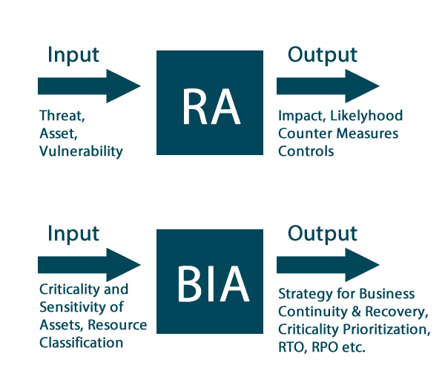
Risk Management, Security Policies, and Standards
Security+
Session 12
Business Impact Analysis (BIA)
Identify the impact of a disruption on mission-critical systems, essential to core business functionality, and define impact and recovery plans.
Comparing Risk Analysis to Business Impact Analysis
Identify Critical Functions
Identify the functions necessary to continue operations until full service
can be restored.
2. Prioritize Critical Business Functions
Prioritize business operations as mission-critical or non-essential
functions.
Calculate Timeframe for Critical Systems Loss
Determine the length of time the organization can survive without
critical functions. Impacts are determined based on variables such as:
Life, Property, Safety, Finance, Reputation
4. Estimate Tangible and Intangible Impact on the Organization
Estimate the losses for an event as tangible costs, and intangible
impacts on the organization.
BIA Metrics: MTD, RPO, RTO, MTBF, MTTR

Slide 31
Risk Management, Security Policies, and Standards
Security+
Session 12
The Risk Assessment Process
Best Practices for Risk Assessments
Create a risk assessment policy
Inventory and maintain a database of IT infrastructure components and IT assets.
Define risk assessment goals and objectives in line with organization goals.
Identify a consistent risk assessment methodology and approach
Conduct an asset valuation or asset criticality valuation
Limit the scope of the risk assessment by identifying and categorizing IT infrastructure
Understand and evaluate risks, threats, and vulnerabilities to the IT infrastructure
Define a consistent standard for securing the organizations IT infrastructure
Create a Business Continuity Plan in the case of a disaster or emergency
Perform the risk and vulnerability assessment by defined standards

Slide 32
Risk Management, Security Policies, and Standards
Security+
Session 12
Risk Analysis Options
Based on the organization's tolerance for risk, and the risk score based on the risk matrix, a response is determined for handling potential risks.
Avoid – To eliminate the practice, or not become involved in the risk activity.
Accept – Accept the risk activity, and the potential for any costs to the organization.
Transfer – Transfer the risk to a third party. Best practice is to obtain insurance for the risk.
Mitigate – Implement a control to reduce the risk. Such as a firewall for the network.

Slide 33
Risk Management, Security Policies, and Standards
Security+
Session 12
Cloud Computing Risks
Platform-as-a-Service (PaaS)
The capability for the consumer to deploy their own applications onto the cloud platform infrastructure, but with no management control over the cloud infrastructure. Including networks, servers, operating systems, or storage. The consumer has control over the deployed applications and possibly configuration settings for the application-hosting environment.
Infrastructure-as-a-Service (IaaS)
A cloud solution where you are purchasing infrastructure, virtual machines and other resources as a service to subscribers. A host server hypervisor runs the virtual machines as guests.
Software-as-a-Service (SaaS)
The capability provided to the consumer to use the cloud provider’s applications running on a cloud infrastructure. The consumer does not manage or control the underlying cloud infrastructure including networks, servers, operating systems, storage or application capabilities, and with limited user-specific application configuration settings.

Slide 34
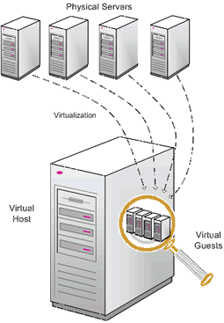
Risk Management, Security Policies, and Standards
Security+
Session 12
Risks Associated with Virtualization
Misconfigured Platforms – Virtualization requires additional administrator skills.
Live VM Migration – During migration, an attacker could attempt a man-in-the-middle attack and sniff the data as it moves over the network.
Data Remanence – Residual data from previous VMs provisioned and de-provisioned.
Single Point of Failure
Intermingling Network and Security Controls – Could lead to Privilege Elevation and compromise of security.

Slide 35
Incident Response and Forensics
Session 11
Security+
NEXT STEPS
STUDY!! STUDY!! STUDY!!
Read – Study Guide, Articles, Session Slides
Watch Videos – Professor Messer, Pearson, Youtube, Udemy (Jason Dion)
Practice tests – practice, practice, practice
FINAL EXAM – As soon as you complete the 5 individual tests,
then Request the Final Exam.
It will be emailed to you, and you will need to take it and return it via email.
Turn in Homework assignments
Vouchers can be requested as soon as all assignments have been turned it and verified.

Slide 36
Risk Management, Security Policies, and Standards
Security+
Session 12
Thank You!!
Send questions and slide deck requests to:
Jim Reeves
Security+, CASP+,CySA+, CISSP, ITILv3, CTT+
MCSE, MCSD, MCT
jireeves@Deloitte.com

